Slide 1
W4111 – Introduction to Databases Module II (2), NoSQL (2)
© Donald F. Ferguson, 2025

Slide 2

Module II – DBMS Architecture and Implementation
2 | W4111-2025S-09-Module-II-NoSql-2 © Donald F. Ferguson, 2025

Slide 3

Module II – DBMS Architecture and Implementation
Overview and Reminder
3 | W4111-2025S-09-Module-II-NoSql-2 © Donald F. Ferguson, 2025

Slide 4

Course Modules – Reminder

Slide 5
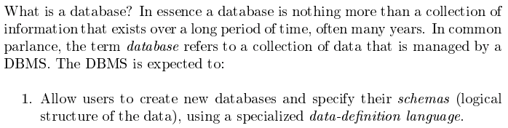
Module II – DBMS Architecture and Implementation
Covered for the relational model.
Database Systems: The Complete Book (2nd Edition) by Hector Garcia-Molina (Author), Jeffrey D. Ullman (Author), Jennifer Widom (Author)

Slide 6
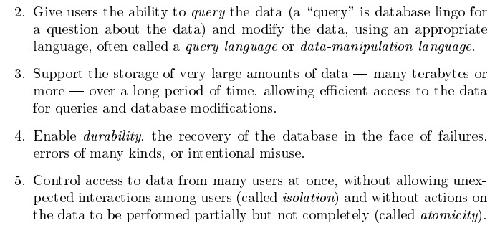
Module II – DBMS Architecture and Implementation
Database Systems: The Complete Book (2nd Edition) by Hector Garcia-Molina (Author), Jeffrey D. Ullman (Author), Jennifer Widom (Author)

Slide 7
Purpose of Database Systems
In the early days, database applications were built directly on top of file systems, which leads to:
Data redundancy and inconsistency: data is stored in multiple file formats resulting induplication of information in different files
Difficulty in accessing data
Need to write a new program to carry out each new task
Data isolation
Multiple files and formats
Integrity problems
Integrity constraints (e.g., account balance > 0) become “buried” in program code rather than being stated explicitly
Hard to add new constraints or change existing ones
Notes:
7

Slide 8
Purpose of Database Systems (Cont.)
Atomicity of updates
Failures may leave database in an inconsistent state with partial updates carried out
Example: Transfer of funds from one account to another should either complete or not happen at all
Concurrent access by multiple users
Concurrent access needed for performance
Uncontrolled concurrent accesses can lead to inconsistencies
Ex: Two people reading a balance (say 100) and updating it by withdrawing money (say 50 each) at the same time
Security problems
Hard to provide user access to some, but not all, data
Database systems offer solutions to all the above problems
Notes:
8

Slide 9
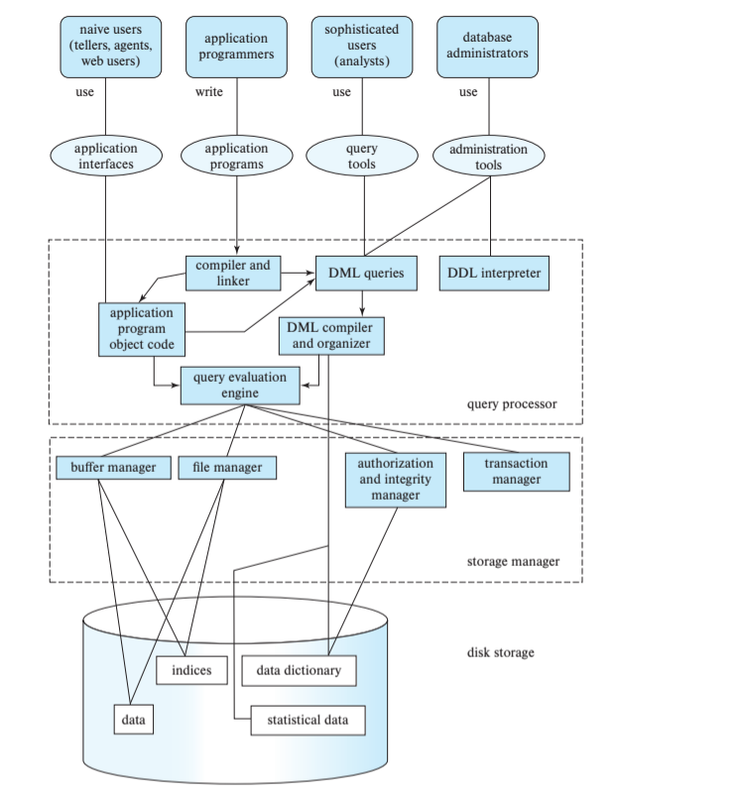
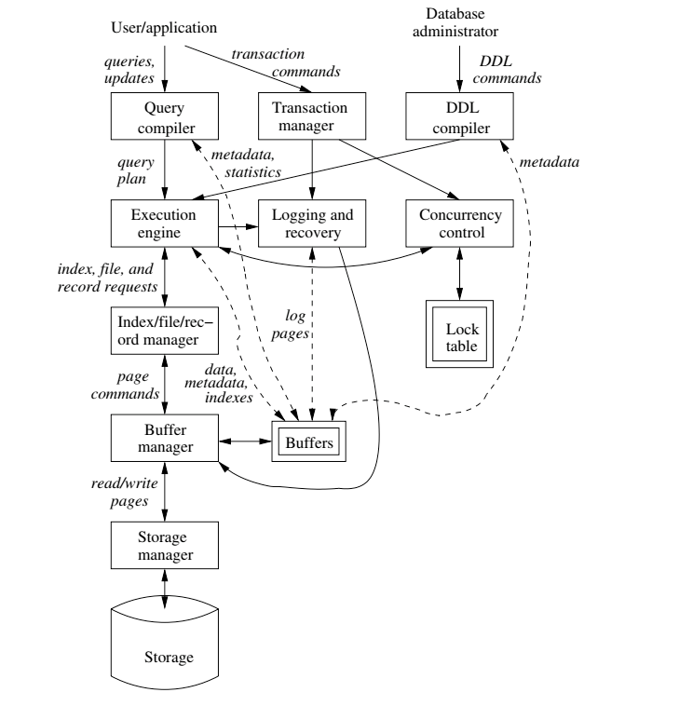
DBMS Arch.

Slide 10

Data Management
Last Week
Storage
Today
Storage Manager
Buffer Manager
Index Manager (1)
Database Systems: The Complete Book (2nd Edition) by Hector Garcia-Molina (Author), Jeffrey D. Ullman (Author), Jennifer Widom (Author)

Slide 11
Data Storage and File Organization
11 | W4111-2025S-09-Module-II-NoSql-2 © Donald F. Ferguson, 2025

Slide 12
File Organization
The database is stored as a collection of files. Each file is a sequence of records. A record is a sequence of fields.
One approach
Assume record size is fixed
Each file has records of one particular type only
Different files are used for different relations
This case is easiest to implement; will consider variable length records later
We assume that records are smaller than a disk block
.

Slide 13
Terminology
A tuple in a relation maps to a record. Records may be
Fixed length
Variable length
Variable format (which we will see in Neo4J, DynamoDB, etc).
A block
Is the unit of transfer between disks and memory (buffer pools).
Contains multiple records, usually but not always from the same relation.
The database address space contains
All of the blocks and records that the database manages
Including blocks/records containing data
And blocks/records containing free space.

Slide 14
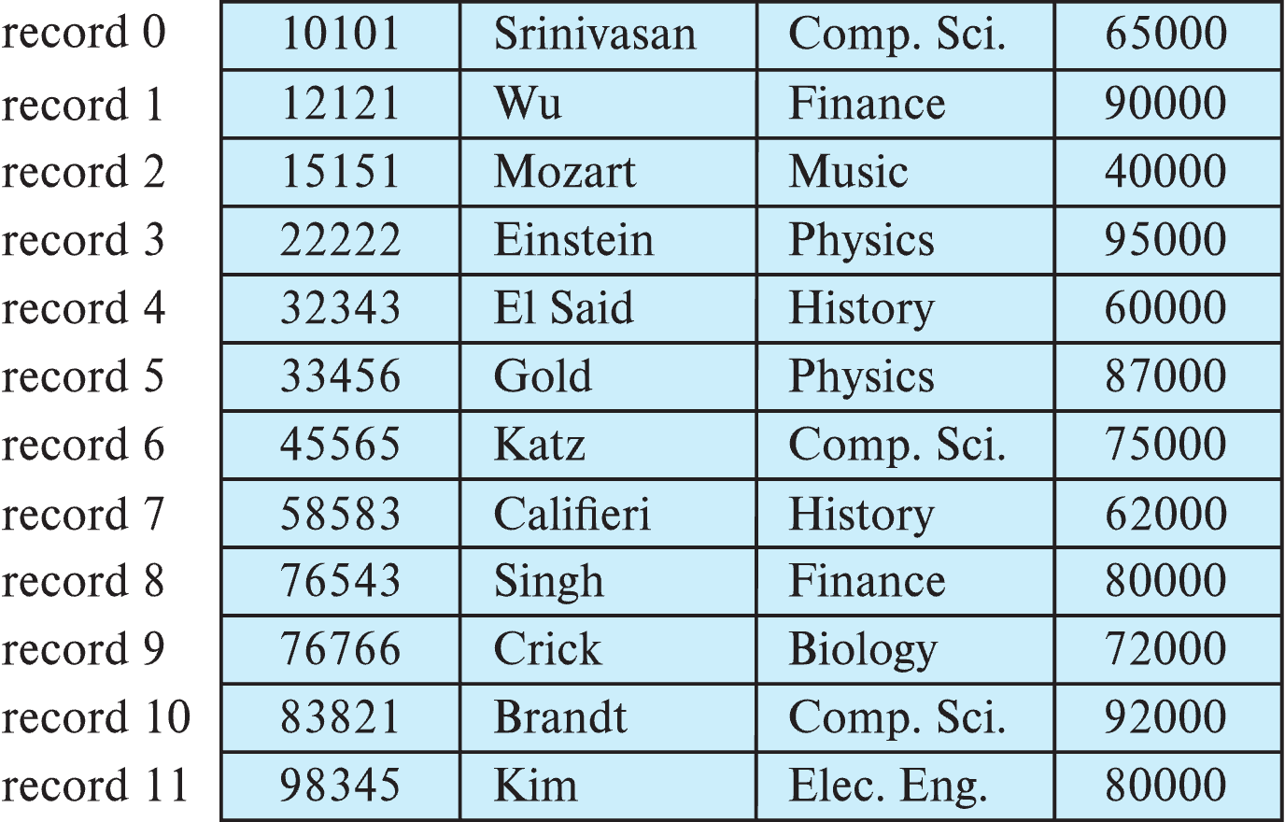
Fixed-Length Records
Simple approach:
Store record i starting from byte n ∗ (i – 1), where n is the size of each record.
Record access is simple but records may cross blocks
Modification: do not allow records to cross block boundaries

Slide 15
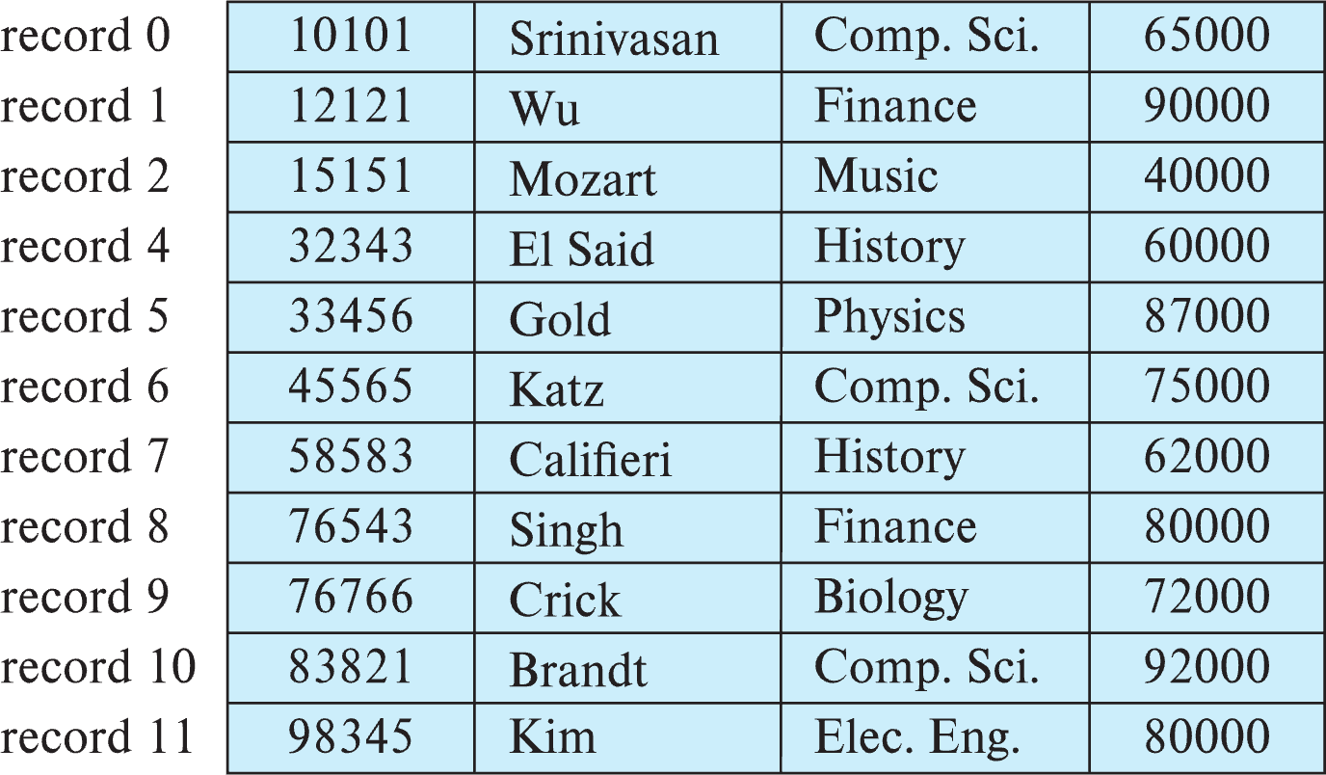
Fixed-Length Records
Deletion of record i: alternatives:
move records i + 1, . . ., n to i, . . . , n – 1
move record n to i
do not move records, but link all free records on a free list
Record 3 deleted

Slide 16
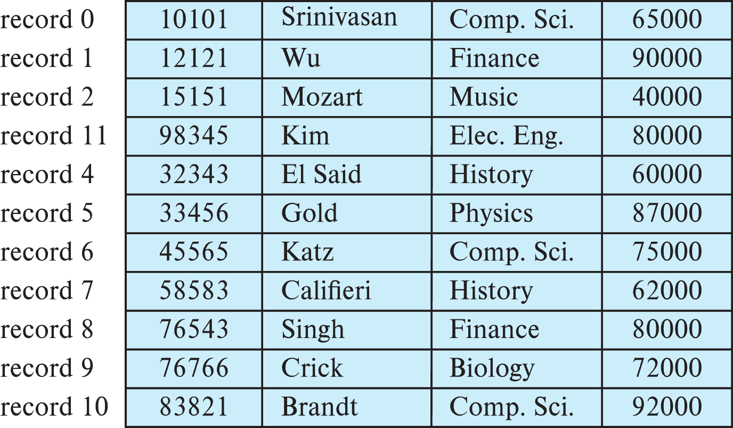
Fixed-Length Records
Deletion of record i: alternatives:
move records i + 1, . . ., n to i, . . . , n – 1
move record n to i
do not move records, but link all free records on a free list
Record 3 deleted and replaced by record 11

Slide 17
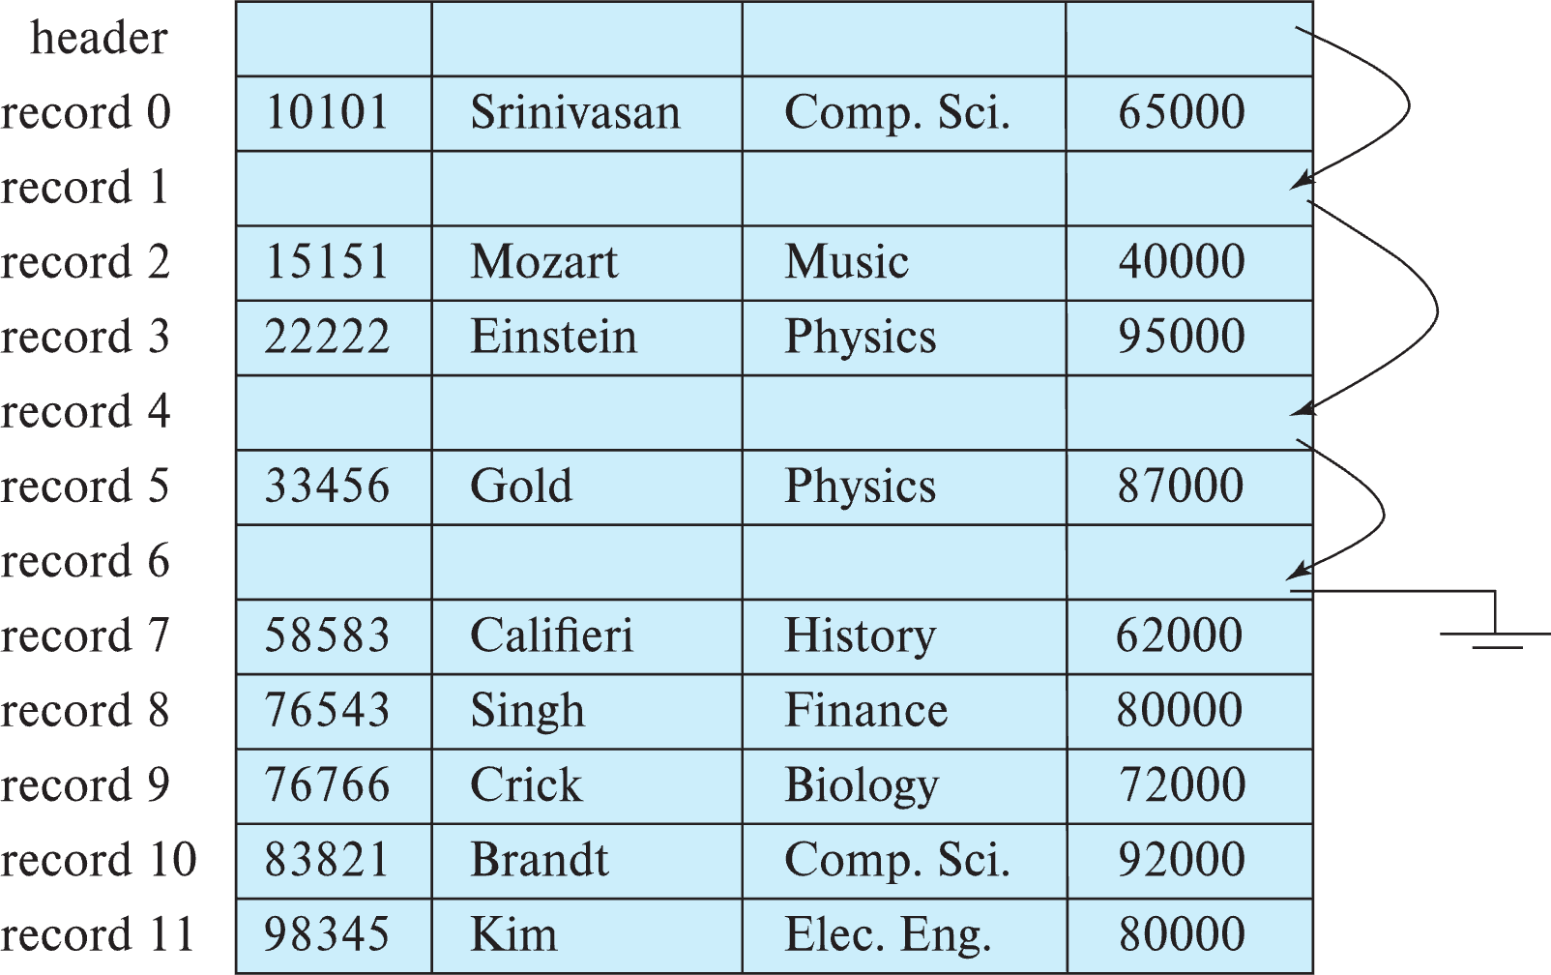
Fixed-Length Records
Deletion of record i: alternatives:
move records i + 1, . . ., n to i, . . . , n – 1
move record n to i
do not move records, but link all free records on a free list

Slide 18
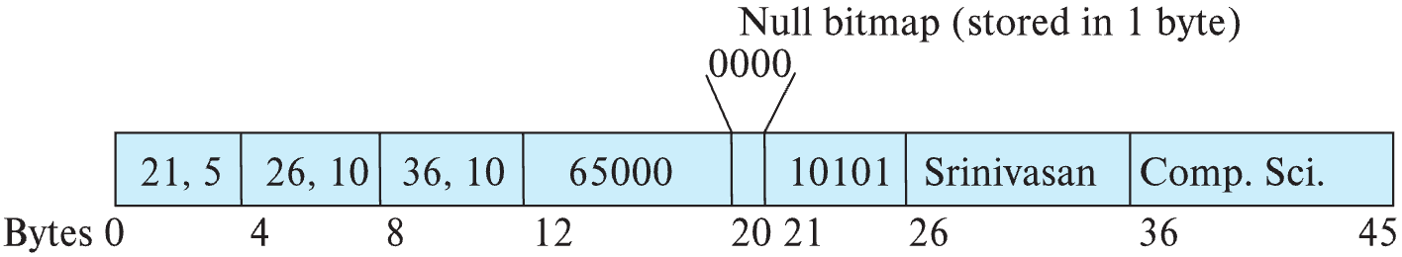
Variable-Length Records
Variable-length records arise in database systems in several ways:
Storage of multiple record types in a file.
Record types that allow variable lengths for one or more fields such as strings (varchar)
Record types that allow repeating fields (used in some older data models).
Attributes are stored in order
Variable length attributes represented by fixed size (offset, length), with actual data stored after all fixed length attributes
Null values represented by null-value bitmap

Slide 19
Variable-Length Records: Slotted Page Structure
Slotted page header contains:
number of record entries
end of free space in the block
location and size of each record
Records can be moved around within a page to keep them contiguous with no empty space between them; entry in the header must be updated.
Pointers should not point directly to record — instead they should point to the entry for the record in header.

Slide 20
Storing Large Objects
E.g., blob/clob types
Records must be smaller than pages
Alternatives:
Store as files in file systems
Store as files managed by database
Break into pieces and store in multiple tuples in separate relation
PostgreSQL TOAST

Slide 21
Organization of Records in Files
Heap – record can be placed anywhere in the file where there is space
Sequential – store records in sequential order, based on the value of the search key of each record
In a multitable clustering file organization records of several different relations can be stored in the same file
Motivation: store related records on the same block to minimize I/O
B⁺-tree file organization
Ordered storage even with inserts/deletes
More on this in Chapter 14
Hashing – a hash function computed on search key; the result specifies in which block of the file the record should be placed
More on this in Chapter 14

Slide 22
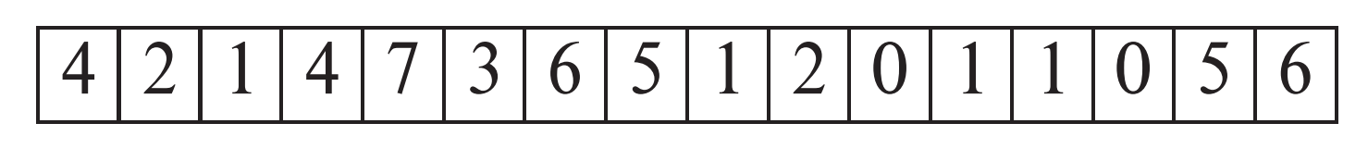
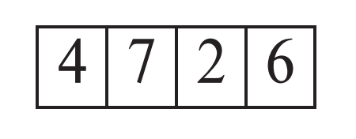
Heap File Organization
Records can be placed anywhere in the file where there is free space
Records usually do not move once allocated
Important to be able to efficiently find free space within file
Free-space map
Array with 1 entry per block. Each entry is a few bits to a byte, and records fraction of block that is free
In example below, 3 bits per block, value divided by 8 indicates fraction of block that is free
Can have second-level free-space map
In example below, each entry stores maximum from 4 entries of first-level free-space map
Free space map written to disk periodically, OK to have wrong (old) values for some entries (will be detected and fixed)

Slide 23
Sequential File Organization
Suitable for applications that require sequential processing of the entire file
The records in the file are ordered by a search-key

Slide 24
Sequential File Organization (Cont.)
Deletion – use pointer chains
Insertion –locate the position where the record is to be inserted
if there is free space insert there
if no free space, insert the record in an overflow block
In either case, pointer chain must be updated
Need to reorganize the file from time to time to restore sequential order

Slide 25
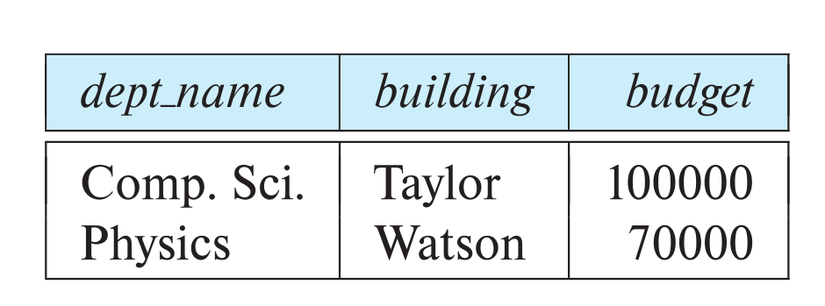
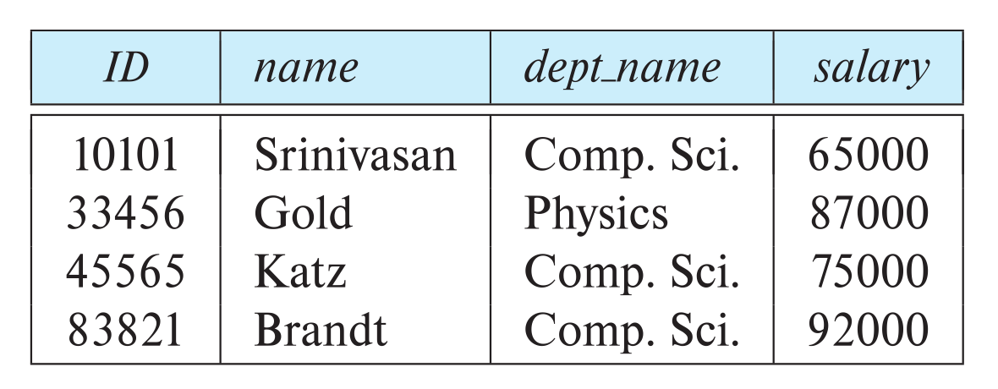
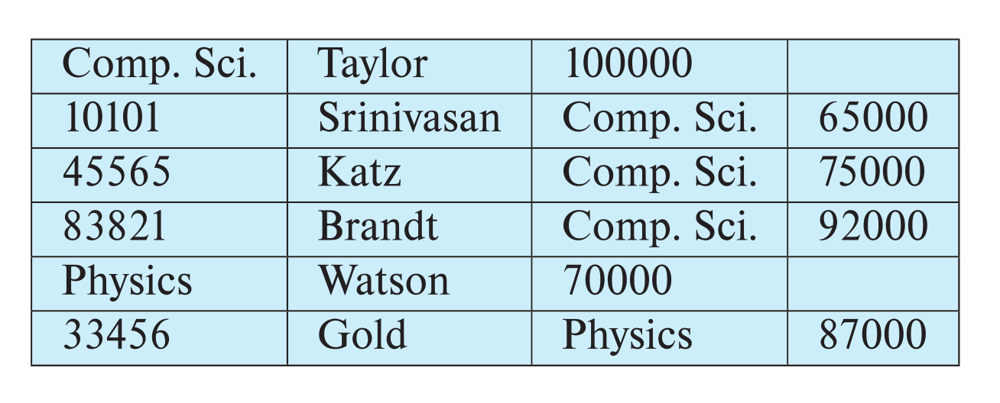
Multitable Clustering File Organization
Store several relations in one file using a multitable clustering file organization
department
instructor
multitable clustering
of department and
instructor

Slide 26
Multitable Clustering File Organization (cont.)
good for queries involving department ⨝ instructor, and for queries involving one single department and its instructors
bad for queries involving only department
results in variable size records
Can add pointer chains to link records of a particular relation

Slide 27
Partitioning
Table partitioning: Records in a relation can be partitioned into smaller relations that are stored separately
E.g., transaction relation may be partitioned into transaction_2018, transaction_2019, etc.
Queries written on transaction must access records in all partitions
Unless query has a selection such as year=2019, in which case only one partition in needed
Partitioning
Reduces costs of some operations such as free space management
Allows different partitions to be stored on different storage devices
E.g., transaction partition for current year on SSD, for older years on magnetic disk

Slide 28
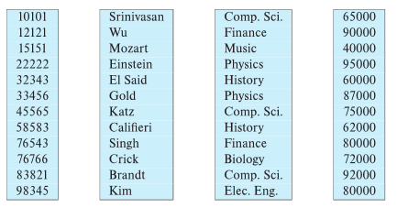
Column-Oriented Storage
Also known as columnar representation
Store each attribute of a relation separately
Example

Slide 29
Columnar Representation
Benefits:
Reduced IO if only some attributes are accessed
Improved CPU cache performance
Improved compression
Vector processing on modern CPU architectures
Drawbacks
Cost of tuple reconstruction from columnar representation
Cost of tuple deletion and update
Cost of decompression
Columnar representation found to be more efficient for decision support than row-oriented representation
Traditional row-oriented representation preferable for transaction processing
Some databases support both representations
Called hybrid row/column stores

Slide 30
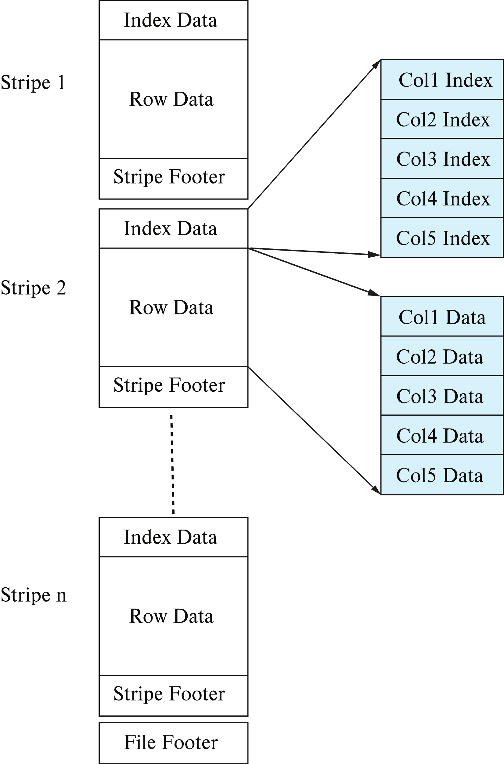
Columnar File Representation
ORC and Parquet: file formats with columnar storage inside file
Very popular for big-data applications
Orc file format shown on right:

Slide 31
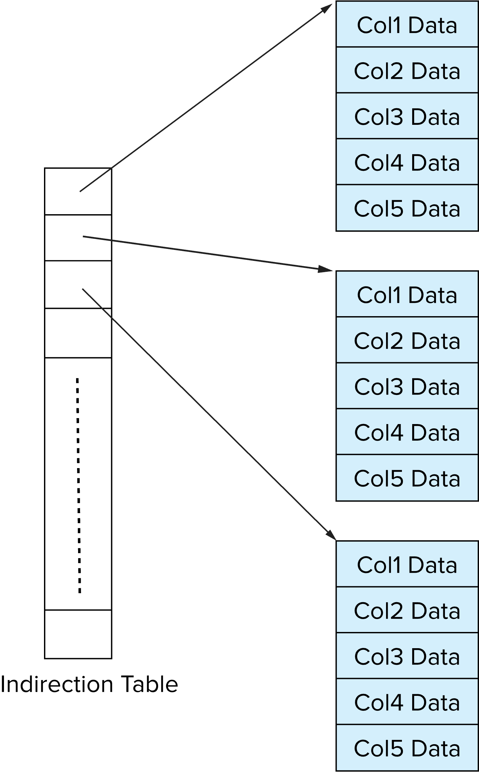
Storage Organization in Main-Memory Databases
Can store records directly in memory without a buffer manager
Column-oriented storage can be used in-memory for decision support applications
Compression reduces memory requirement

Slide 32
Row vs Column
Columnar and Row are both
Relational
Support SQL operations
But differ in data storage
Row keeps row data together in blocks.
Columnar keys column data together in blocks.
This determines performance for different types of query, e.g.
Columnar is extremely powerful for BI scenarios
Aggregation ops, e.g. SUM, AVG
PROJECT (do not load all of the row) to get a few columns
Row is powerful for OLTP. Transaction typically create and retrieve
One row at a time
All the columns of a single row.

Slide 33
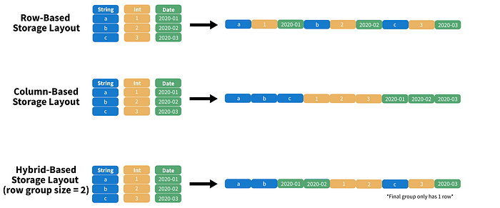
Columnar File Representation
https://towardsdatascience.com/demystifying-the-parquet-file-format-13adb0206705
Apache parquet is an open-source file format that provides efficient storage and fast read speed. It uses a hybrid storage format which sequentially stores chunks of columns, lending to high performance when selecting and filtering data. On top of strong compression algorithm support (snappy, gzip, LZO), it also provides some clever tricks for reducing file scans and encoding repeat variables.

Slide 34
Buffer Manager
34 | W4111-2025S-09-Module-II-NoSql-2 © Donald F. Ferguson, 2025

Slide 35
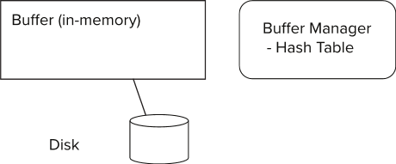
Storage Access
Blocks are units of both storage allocation and data transfer.
Database system seeks to minimize the number of block transfers between the disk and memory. We can reduce the number of disk accesses by keeping as many blocks as possible in main memory.
Buffer – portion of main memory available to store copies of disk blocks.
Buffer manager – subsystem responsible for allocating buffer space in main memory.
Notes:
35

Slide 36
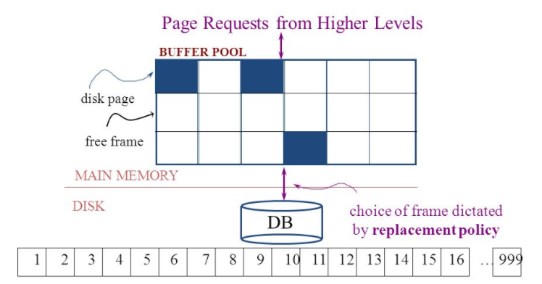
The Logical Concept
The DBMS and queries can only manipulate in-memory blocks and records.
A very, very, very small fraction of all blocks fit in memory.

Slide 37
Buffer Manager
Programs call on the buffer manager when they need a block from disk.
If the block is already in the buffer, buffer manager returns the address of the block in main memory
If the block is not in the buffer, the buffer manager
Allocates space in the buffer for the block
Replacing (throwing out) some other block, if required, to make space for the new block.
Replaced block written back to disk only if it was modified since the most recent time that it was written to/fetched from the disk.
Reads the block from the disk to the buffer, and returns the address of the block in main memory to requester.
Notes:
37

Slide 38
Buffer Manager
Buffer replacement strategy (details coming up!)
Pinned block: memory block that is not allowed to be written back to disk
Pin done before reading/writing data from a block
Unpin done when read /write is complete
Multiple concurrent pin/unpin operations possible
Keep a pin count, buffer block can be evicted only if pin count = 0
Shared and exclusive locks on buffer
Needed to prevent concurrent operations from reading page contents as they are moved/reorganized, and to ensure only one move/reorganize at a time
Readers get shared lock, updates to a block require exclusive lock
Locking rules:
Only one process can get exclusive lock at a time
Shared lock cannot be concurrently with exclusive lock
Multiple processes may be given shared lock concurrently

Slide 39
Buffer-Replacement Policies
Most operating systems replace the block least recently used (LRU strategy)
Idea behind LRU – use past pattern of block references as a predictor of future references
LRU can be bad for some queries
Queries have well-defined access patterns (such as sequential scans), and a database system can use the information in a user’s query to predict future references
Mixed strategy with hints on replacement strategy provided by the query optimizer is preferable
Example of bad access pattern for LRU: when computing the join of 2 relations r and s by a nested loops
for each tuple tr of r do for each tuple ts of s do if the tuples tr and ts match …
Notes:
39

Slide 40
Buffer-Replacement Policies (Cont.)
Toss-immediate strategy – frees the space occupied by a block as soon as the final tuple of that block has been processed
Most recently used (MRU) strategy – system must pin the block currently being processed. After the final tuple of that block has been processed, the block is unpinned, and it becomes the most recently used block.
Buffer manager can use statistical information regarding the probability that a request will reference a particular relation
E.g., the data dictionary is frequently accessed. Heuristic: keep data-dictionary blocks in main memory buffer
Operating system or buffer manager may reorder writes
Can lead to corruption of data structures on disk
E.g., linked list of blocks with missing block on disk
File systems perform consistency check to detect such situations
Careful ordering of writes can avoid many such problems
Notes:
40

Slide 41
Replacement Policy
The replacement policy is one of the most important factors in database management system implementation and configuration.
A very simple, introductory explanation is (https://en.wikipedia.org/wiki/Cache_replacement_policies).
There are a lot of possible policies.
The most efficient caching algorithm would be to always discard the information that will not be needed for the longest time in the future. This optimal result is referred to as Bélády's optimal algorithm/simply optimal replacement policy or the clairvoyant algorithm.
All implementable policies are an attempt to approximate knowledge of the future based on knowledge of the past.
Least Recently Used is based on the simplest assumption
The information that will not be needed for the longest time.
Is the information that has not been accessed for the longest time.

Slide 42
Replacement Algorithm
The algorithms are more sophisticated in the real world, e.g.
“Scans” are common, e.g. go through a large query result in order (will be more clear when discussing cursors).
The engine knows the current position in the result set.
Uses the sort order to determine which records will be accessed soon.
Tags those blocks as not replaceable.
(A form of clairvoyance).
Not all users/applications are equally “important.”
Classify users/applications into priority 1, 2 and 3.
Sub-allocate the buffer pool into pools P1, P2 and P3.
Apply LRU within pools and adjust pool sizes based on relative importance.
This prevents
A high access rate, low-priority application from taking up a lot of frames
Result in low access, high priority applications not getting buffer hits.

Slide 43
Optimization of Disk Block Access (Cont.)
Buffer managers support forced output of blocks for the purpose of recovery (more in Chapter 19)
Nonvolatile write buffers speed up disk writes by writing blocks to a non-volatile RAM or flash buffer immediately
Writes can be reordered to minimize disk arm movement
Log disk – a disk devoted to writing a sequential log of block updates
Used exactly like nonvolatile RAM
Write to log disk is very fast since no seeks are required
Journaling file systems write data in-order to NV-RAM or log disk
Reordering without journaling: risk of corruption of file system data

Slide 44
Indexes
44 | W4111-2025S-09-Module-II-NoSql-2 © Donald F. Ferguson, 2025

Slide 45
Basic Concepts
Indexing mechanisms used to speed up access to desired data.
E.g., author catalog in library
Search Key - attribute to set of attributes used to look up records in a file.
An index file consists of records (called index entries) of the form
Index files are typically much smaller than the original file
Two basic kinds of indices:
Ordered indices: search keys are stored in sorted order
Hash indices: search keys are distributed uniformly across “buckets” using a “hash function”.
search-key
pointer
search-key
pointer
(“c:\”, LBN, offset)
search-key
pointer
search-key
pointer

Slide 46
Ordered Indices
In an ordered index, index entries are stored sorted on the search key value.
Clustering index: in a sequentially ordered file, the index whose search key specifies the sequential order of the file.
Also called primary index
The search key of a primary index is usually but not necessarily the primary key.
Secondary index: an index whose search key specifies an order different from the sequential order of the file. Also called nonclustering index.
Index-sequential file: sequential file ordered on a search key, with a clustering index on the search key.

Slide 47
Dense Index Files
Dense index — Index record appears for every search-key value in the file.
E.g. index on ID attribute of instructor relation

Slide 48
Dense Index Files (Cont.)
Dense index on dept_name, with instructor file sorted on dept_name

Slide 49
Sparse Index Files
Sparse Index: contains index records for only some search-key values.
Applicable when records are sequentially ordered on search-key
To locate a record with search-key value K we:
Find index record with largest search-key value < K
Search file sequentially starting at the record to which the index record points

Slide 50
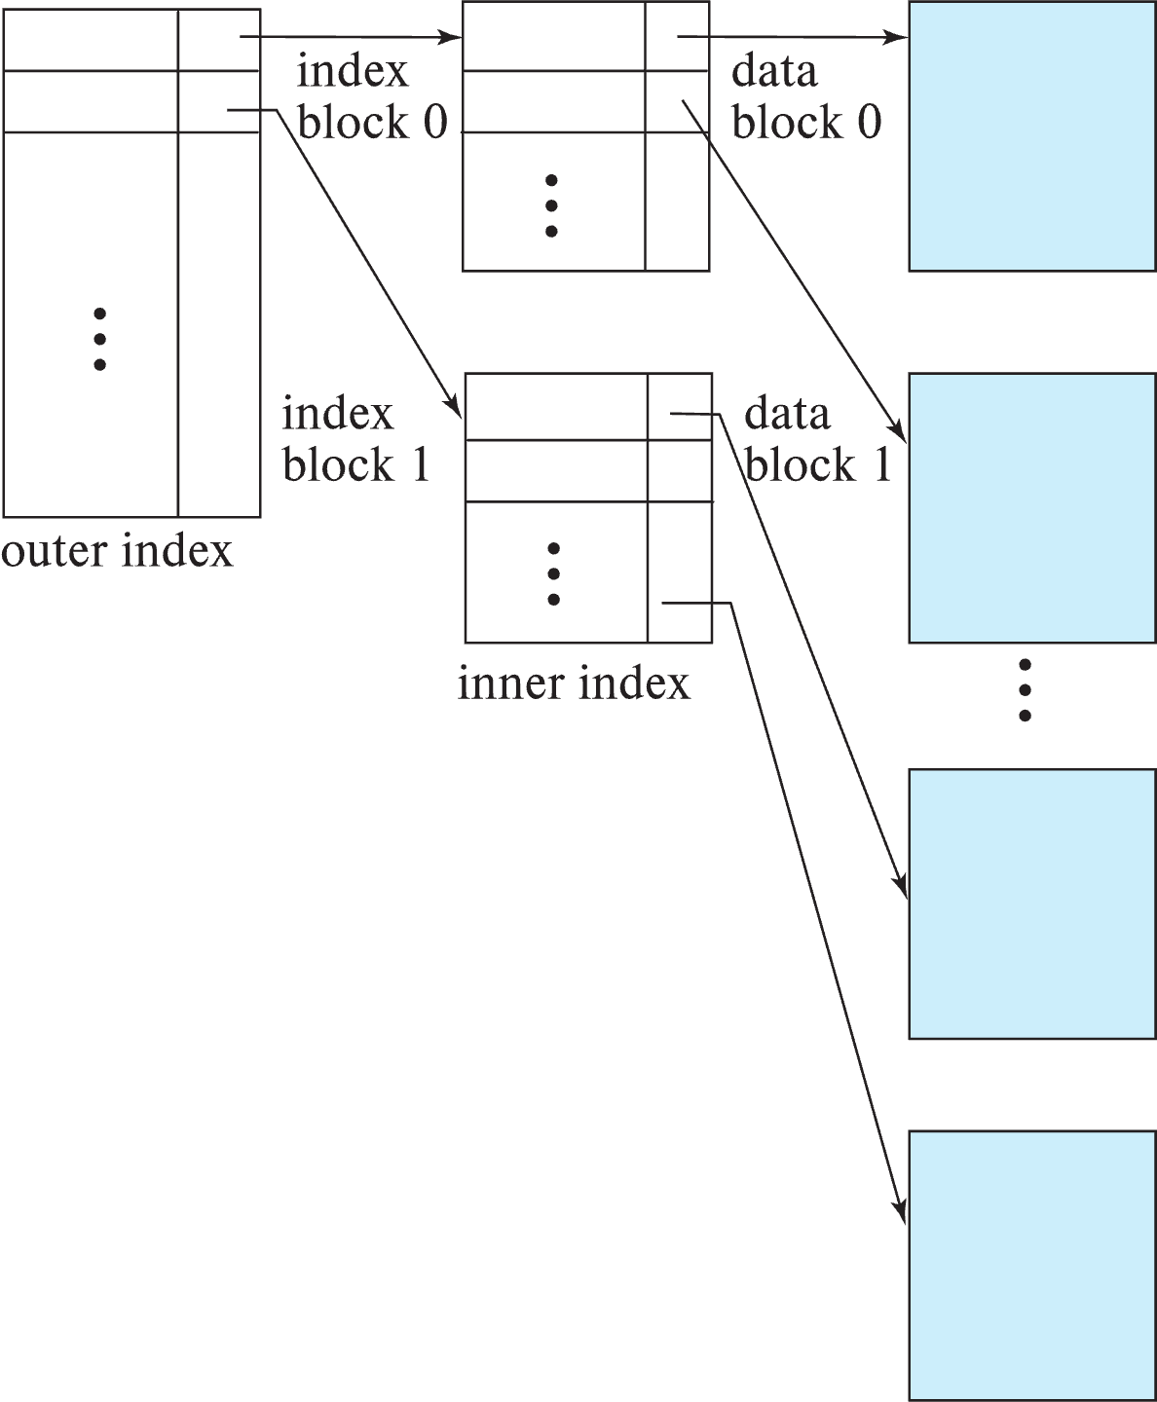
Sparse Index Files (Cont.)
Compared to dense indices:
Less space and less maintenance overhead for insertions and deletions.
Generally slower than dense index for locating records.
Good tradeoff:
for clustered index: sparse index with an index entry for every block in file, corresponding to least search-key value in the block.
For unclustered index: sparse index on top of dense index (multilevel index)

Slide 51
Secondary Indices Example
Secondary index on salary field of instructor
Index record points to a bucket that contains pointers to all the actual records with that particular search-key value.
Secondary indices have to be dense

Slide 52
Clustering vs Nonclustering Indices
Indices offer substantial benefits when searching for records.
BUT: indices imposes overhead on database modification
when a record is inserted or deleted, every index on the relation must be updated
When a record is updated, any index on an updated attribute must be updated
Sequential scan using clustering index is efficient, but a sequential scan using a secondary (nonclustering) index is expensive on magnetic disk
Each record access may fetch a new block from disk
Each block fetch on magnetic disk requires about 5 to 10 milliseconds

Slide 53
Indices on Multiple Keys
Composite search key
E.g., index on instructor relation on attributes (name, ID)
Values are sorted lexicographically
E.g. (John, 12121) < (John, 13514) and (John, 13514) < (Peter, 11223)
Can query on just name, or on (name, ID)
(nameLast, nameFirst, birthyear)
nameLast [nameLast = “Ferguson”] [nameLast like “Fer%”]
nameLast, nameFirst
nameLast, nameFirst, birthyear
NOT and index on
nameFirst, nameLast
birthyear
nameLast like [%er%]

Slide 54
B⁺-Tree Index Files
Disadvantage of indexed-sequential files
Performance degrades as file grows, since many overflow blocks get created.
Periodic reorganization of entire file is required.
Advantage of B⁺-tree index files:
Automatically reorganizes itself with small, local, changes, in the face of insertions and deletions.
Reorganization of entire file is not required to maintain performance.
(Minor) disadvantage of B⁺-trees:
Extra insertion and deletion overhead, space overhead.
Advantages of B⁺-trees outweigh disadvantages
B⁺-trees are used extensively

Slide 55
Example of B⁺-Tree

Slide 56
B⁺-Tree Index Files (Cont.)
A B⁺-tree is a rooted tree satisfying the following properties:
All paths from root to leaf are of the same length
Each node that is not a root or a leaf has between ⎡n/2⎤ and n children.
A leaf node has between ⎡(n–1)/2⎤ and n–1 values
Special cases:
If the root is not a leaf, it has at least 2 children.
If the root is a leaf (that is, there are no other nodes in the tree), it can have between 0 and (n–1) values.

Slide 57
B⁺-Tree Node Structure
Typical node
K_{i} are the search-key values
P_{i} are pointers to children (for non-leaf nodes) or pointers to records or buckets of records (for leaf nodes).
The search-keys in a node are ordered
K₁ < K₂ < K₃ < . . . < K_{n–1}
(Initially assume no duplicate keys, address duplicates later)

Slide 58
Leaf Nodes in B⁺-Trees
Properties of a leaf node:
For i = 1, 2, . . ., n–1, pointer P_{i} points to a file record with search-key value K_{i},
If L_{i}, L_{j} are leaf nodes and i < j, L_{i}’s search-key values are less than or equal to L_{j}’s search-key values
P_{n} points to next leaf node in search-key order

Slide 59
Non-Leaf Nodes in B⁺-Trees
Non leaf nodes form a multi-level sparse index on the leaf nodes. For a non-leaf node with m pointers:
All the search-keys in the subtree to which P₁ points are less than K₁
For 2 ≤ i ≤ n – 1, all the search-keys in the subtree to which P_{i} points have values greater than or equal to K_{i–1} and less than K_{i}
All the search-keys in the subtree to which P_{n} points have values greater than or equal to K_{n–1}
General structure

Slide 60
Example of B⁺-tree
B⁺-tree for instructor file (n = 6)
Leaf nodes must have between 3 and 5 values (⎡(n–1)/2⎤ and n –1, with n = 6).
Non-leaf nodes other than root must have between 3 and 6 children (⎡(n/2⎤ and n with n =6).
Root must have at least 2 children.

Slide 61
Observations about B⁺-trees
Since the inter-node connections are done by pointers, “logically” close blocks need not be “physically” close.
The non-leaf levels of the B⁺-tree form a hierarchy of sparse indices.
The B⁺-tree contains a relatively small number of levels
Level below root has at least 2* ⎡n/2⎤ values
Next level has at least 2* ⎡n/2⎤ * ⎡n/2⎤ values
.. etc.
If there are K search-key values in the file, the tree height is no more than ⎡ log_{⎡n/2⎤}(K)⎤
thus searches can be conducted efficiently.
Insertions and deletions to the main file can be handled efficiently, as the index can be restructured in logarithmic time (as we shall see).

Slide 62
Show the Simulator
https://www.cs.usfca.edu/~galles/visualization/BPlusTree.html

Slide 63
Hashing

Slide 64
Static Hashing
A bucket is a unit of storage containing one or more entries (a bucket is typically a disk block).
we obtain the bucket of an entry from its search-key value using a hash function
Hash function h is a function from the set of all search-key values K to the set of all bucket addresses B.
Hash function is used to locate entries for access, insertion as well as deletion.
Entries with different search-key values may be mapped to the same bucket; thus entire bucket has to be searched sequentially to locate an entry.
In a hash index, buckets store entries with pointers to records
In a hash file-organization buckets store records

Slide 65
Handling of Bucket Overflows (Cont.)
Overflow chaining – the overflow buckets of a given bucket are chained together in a linked list.
Above scheme is called closed addressing (also called closed hashing or open hashing depending on the book you use)
An alternative, called open addressing (also called open hashing or closed hashing depending on the book you use) which does not use over- flow buckets, is not suitable for database applications.

Slide 66
Example of Hash File Organization
Hash file organization of instructor file, using dept_name as key.

Slide 67
Deficiencies of Static Hashing
In static hashing, function h maps search-key values to a fixed set of B of bucket addresses. Databases grow or shrink with time.
If initial number of buckets is too small, and file grows, performance will degrade due to too much overflows.
If space is allocated for anticipated growth, a significant amount of space will be wasted initially (and buckets will be underfull).
If database shrinks, again space will be wasted.
One solution: periodic re-organization of the file with a new hash function
Expensive, disrupts normal operations
Better solution: allow the number of buckets to be modified dynamically.

Slide 68
Show the Simulator
http://iswsa.acm.org/mphf/openDSAPerfectHashAnimation/perfectHashAV.html
https://opendsa-server.cs.vt.edu/ODSA/AV/Development/hashAV.html

Slide 69
NoSQL
69 | W4111-2025S-09-Module-II-NoSql-2 © Donald F. Ferguson, 2025

Slide 70
Concepts
70 | W4111-2025S-09-Module-II-NoSql-2 © Donald F. Ferguson, 2025

Slide 71
Overview (I) (https://en.wikipedia.org/wiki/NoSQL)
A NoSQL (originally referring to "non SQL" or "non relational")^{[1]} database provides a mechanism for storage and retrieval of data that is modeled in means other than the tabular relations used in relational databases. Such databases have existed since the late 1960s, but did not obtain the "NoSQL" moniker until a surge of popularity in the early twenty-first century,^{[2]} triggered by the needs of Web 2.0 companies such as Facebook, Google, and Amazon.com.^{[3][4][5]} NoSQL databases are increasingly used in big data and real-time web applications.^{[6]} NoSQL systems are also sometimes called "Not only SQL" to emphasize that they may support SQL-like query languages.^{[7][8]}
Motivations for this approach include: simplicity of design, simpler "horizontal" scaling to clusters of machines (which is a problem for relational databases),^{[2]} and finer control over availability. The data structures used by NoSQL databases (e.g. key-value, wide column, graph, or document) are different from those used by default in relational databases, making some operations faster in NoSQL. The particular suitability of a given NoSQL database depends on the problem it must solve. Sometimes the data structures used by NoSQL databases are also viewed as "more flexible" than relational database tables.^{[9]}

Slide 72
Overview (I) (https://en.wikipedia.org/wiki/NoSQL)
Many NoSQL stores compromise consistency (in the sense of the CAP theorem) in favor of availability, partition tolerance, and speed. Barriers to the greater adoption of NoSQL stores include the use of low-level query languages (instead of SQL, for instance the lack of ability to perform ad-hoc joins across tables), lack of standardized interfaces, and huge previous investments in existing relational databases.^{[10]} Most NoSQL stores lack true ACID transactions, … …
Instead, most NoSQL databases offer a concept of "eventual consistency" in which database changes are propagated to all nodes "eventually" (typically within milliseconds) so queries for data might not return updated data immediately or might result in reading data that is not accurate, a problem known as stale reads.^{[11]} Additionally, some NoSQL systems may exhibit lost writes and other forms of data loss.^{[12]} Fortunately, some NoSQL systems provide concepts such as write-ahead logging to avoid data loss.^{[13]} For distributed transaction processing across multiple databases, data consistency is an even bigger challenge that is difficult for both NoSQL and relational databases. Even current relational databases "do not allow referential integrity constraints to span databases."^{[14]}

Slide 73
Simplistic Classification (https://medium.com/swlh/4-types-of-nosql-databases-d88ad21f7d3b)
Relational is the foundational model.
We will see OLAP in a future lecture.
Subject of this lecture and part of HW3
We covered graphs and examples.

Slide 74
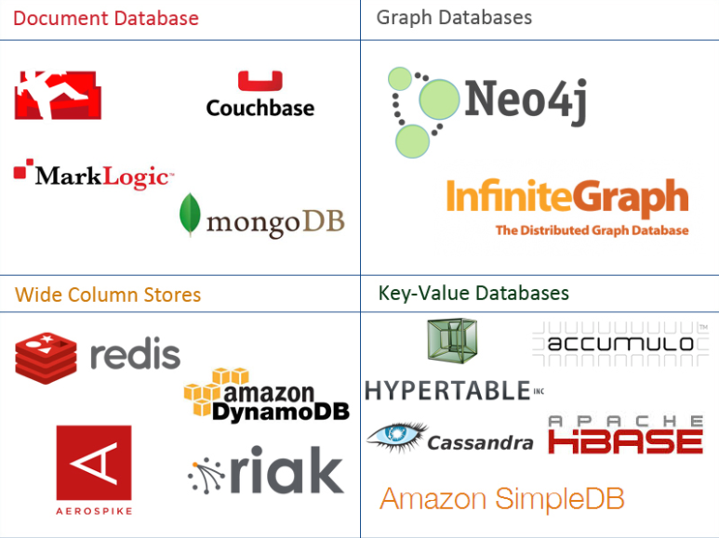
One Taxonomy

Slide 75

Another Taxonomy

Slide 76
Use Cases
Motivations
Massive write performance.
Fast key value look ups.
Flexible schema and data types.
No single point of failure.
Fast prototyping and development.
Out of the box scalability.
Easy maintenance.
What is wrong with SQL/Relational?
Nothing. One size fits all? Not really.
Impedance mismatch. – Object Relational Mapping doesn’t work quite well.
Rigid schema design.
Harder to scale.
Replication.
Joins across multiple nodes? Hard.
How does RDMS handle data growth? Hard.
Need for a DBA.
Many programmers are already familiar with it.
Transactions and ACID make development easy.
Lots of tools to use.

Slide 77
Documents
77 | W4111-2025S-09-Module-II-NoSql-2 © Donald F. Ferguson, 2025

Slide 78
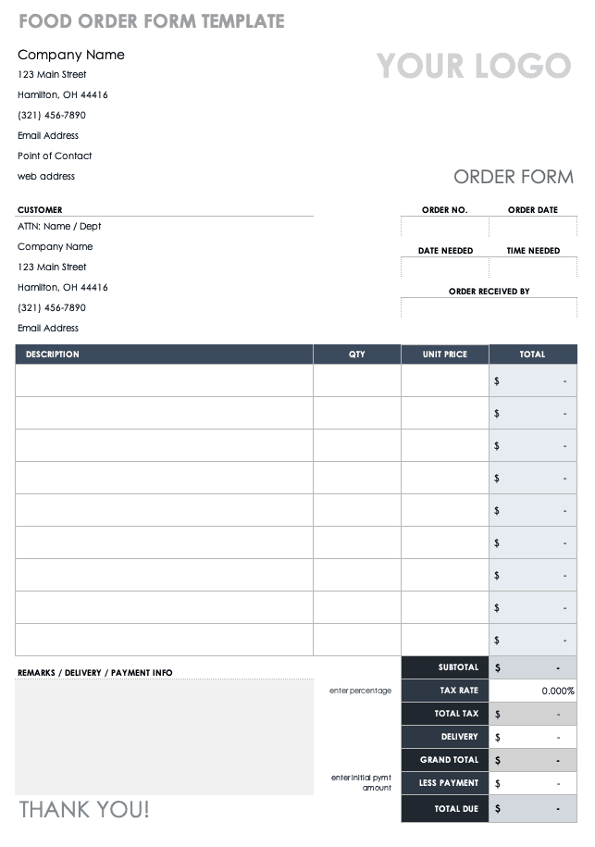
Example Document – An Order
There are 5 entity types on the form:
A “copy of” customer information.
Links (via productCode) to products
Order
OrderDetails
Comments
But OrderDetails and Comments are somehow different from the others.
These are arrays of objects
That are sort of “inside” the order.
These are weak entities, but relational does not always handle these well.

Slide 79
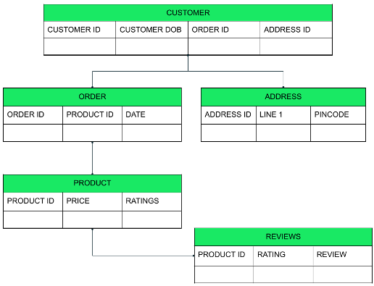
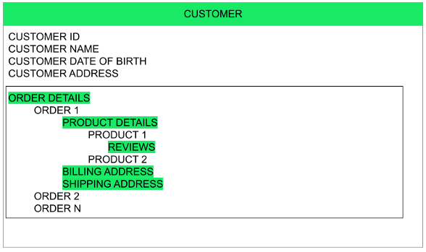
Relational vs Document
Relational
Document
The key difference?
Relational DB attributes are atomic.
Document DB attributes may be multi-valued. composite and lists.

Slide 80
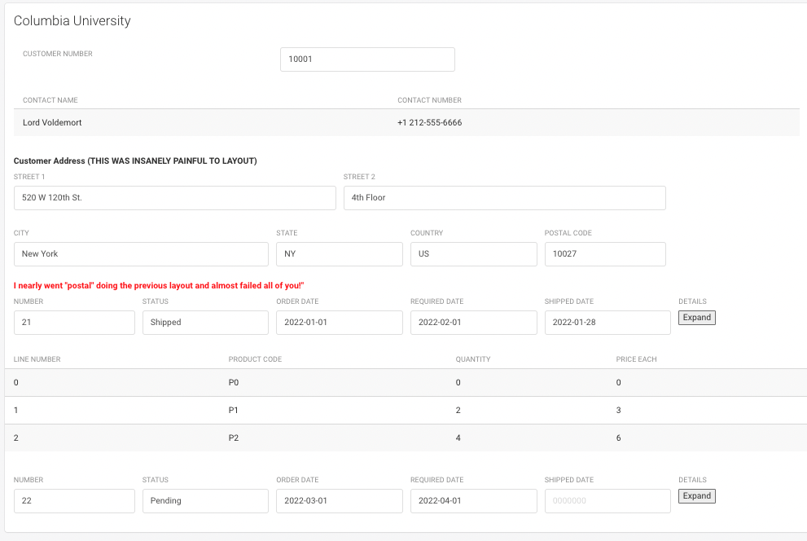
UI Interface and Logical Data Model
{
customerName: “Columbia University”,
contact: {
name: “Lord Voldemort”,
phone: “+1 212-555-6666”
},
address: {
line1: “520 W 120th St.”
line2: “Floor 4”,
… …
}
orders: [
{
number: …,
… …
details: [
… …
]
}
]
}
Note to DFF: Start
~/Dropbox/000/000-A-Current-Examples/W4111-FastAPI-IMDB-Solution
~/Dropbox/000/000-A-Current-Examples/current-dashboard

Slide 81
MongoDB
81 | W4111-2025S-09-Module-II-NoSql-2 © Donald F. Ferguson, 2025

Slide 82
MongoDB Concepts
RDBMS | MongoDB | MongoDB
Database | Database | Database
Table | Collection | Collection
Tuple/Row | Document | Document
column | Field | Field
Table Join | Embedded Documents | Embedded Documents
Primary Key | Primary Key (Default key _id provided by MongoDB itself) | Primary Key (Default key _id provided by MongoDB itself)
Database Server, Client, Tools, Packages
mysqld/Oracle |  | mongod
mysql/sqlplus |  | mongo
DataGrip |  | Compass
pymysql |  | pymongo

Slide 83
Core Operations
Basic Operations:
Create database
Create collection
Create-Retrieve-Update-Delete (CRUD):
Create: insert()
Retrieve:
find()
find_one()
Update: update()
Delete: remove()
More Advanced Concepts:
Limit
Sort
Aggregation Pipelines
Merge
Union
Lookup
Match
Merge
Sample
... ...
We will just cover the basics for now and may cover more things in HW or other lectures.

Slide 84
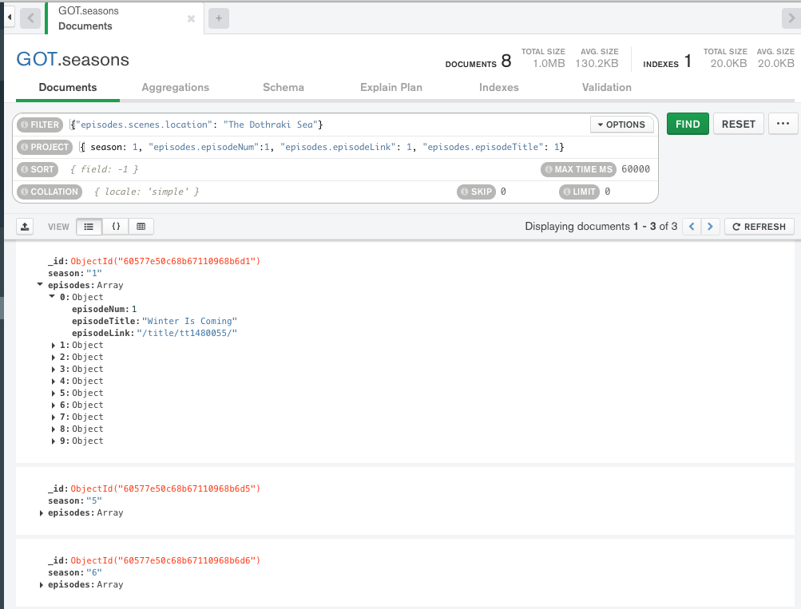
find()
Note:
MongoDB uses a more pymysql approach, e.g. an API, than pure declarative languages like SQL.
The parameters for find() are where the declarative language appears.
The basic forms of find() and find_one() have two parameters:
filter expression
Project expression
You can use the Compass tool and screen captures for some HW and exam answers.
What if I want the answer in a Jupyter Notebook?

Slide 85
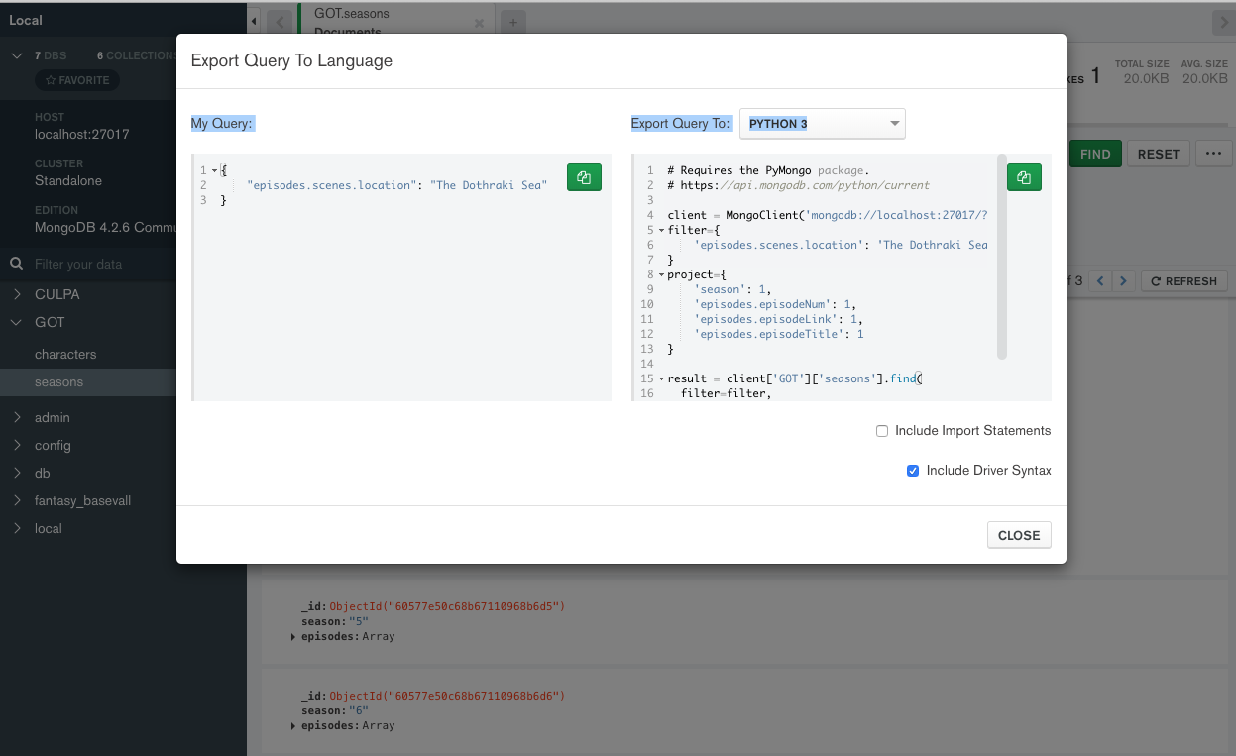
Generate Code
Choose Export to Language.
Copy into the notebook.
The export has an option to include all the connection setup, choosing DB, ... ...
Switch to Notebook

Slide 86
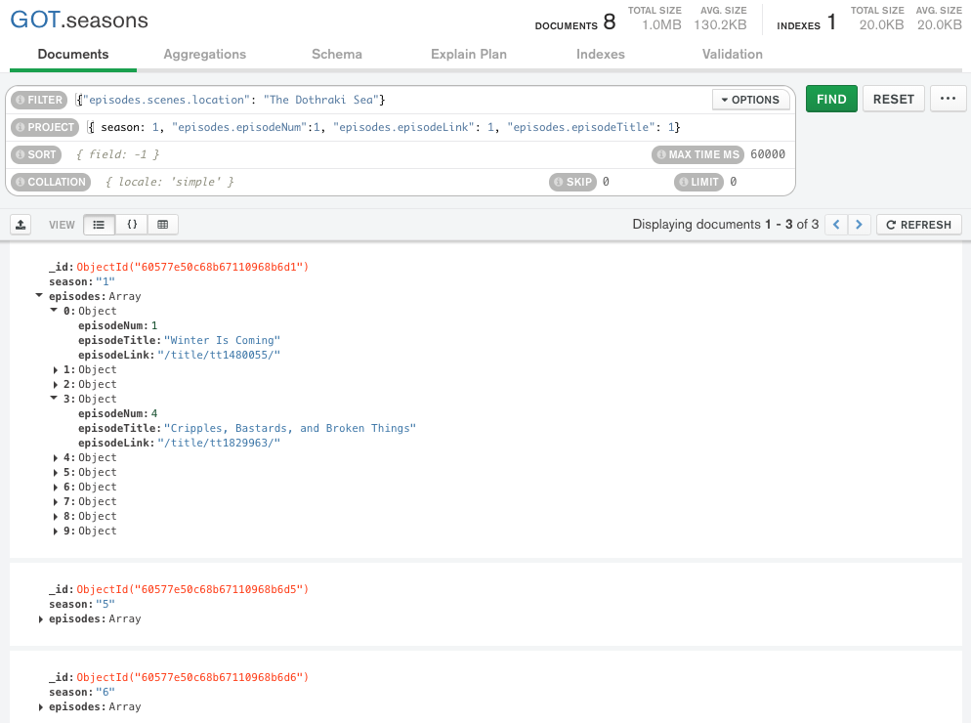
Result is not Quite You Expect
The query returns documents that match.
The document is “Large” and has and episodes and seasons.
If you do a $project requesting episodes/episode content,
You get all episodes in the documents that match.
Not just the episodes with the scene/location.
Projecting array elements from arrays whose elements are arrays is complex and baffling.
You also get back something (a cursor) that is iterable.

Slide 87
Result is not Quite You Expect
The query returns documents that match.
The document is “Large” and has and episodes and seasons.
If you do a $project requesting episodes/episode content,
You get all episodes in the documents that match.
Not just the episodes with the scene/location.
Projecting array elements from arrays whose elements are arrays is complex and baffling.
You also get back something (a cursor) that is iterable.
Net for HWs and exams:
We will keep the queries simple.
The language is as complex as SQL, and we spent several weeks on the language.
Let’s take a look in the Jupyter Notebook on some create and insert functions.
But, first, the datamodel impedance mismatch concept.

Slide 88
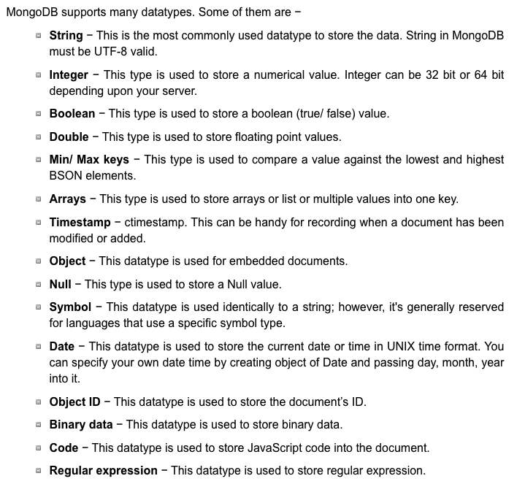
More Fun – Data Types
Python
pymysql
pymongo
SQL
MongoDB

Slide 89
(Some) MongoDB CRUD Operations
Create:
db.collection.insertOne()
db.collection.insertMany()
Retrieve:
db.collection.find()
db.collection.findOne()
db.collection.findOneAndUpdate()
... ..
Update:
db.collection.updateOne()
db.collection.updateMany()
db.collection.replaceOne()
Delete:
db.collection.deleteOne()
db.collection.deleteMany()
pymongo maps the camel case to _, e.g.
findOne()
find_one()
There are good online tutorials:
https://www.tutorialspoint.com/python_data_access
https://www.tutorialspoint.com/mongodb/index.htm

Slide 90
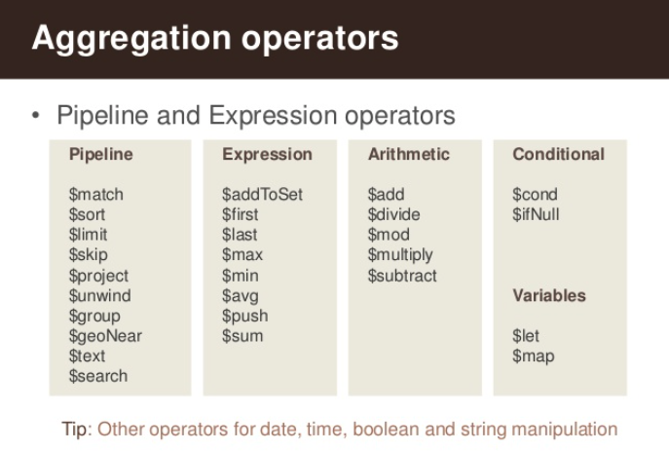
(Some) MongdoDB Pipeline Operators
https://www.slideshare.net/mongodb/s01-e04-analytics

Slide 91
MongoDB Checkpoint
You can see that MongoDB has powerful, sophisticated
Operators
Expressions
Pipelines
We have only skimmed the surface. There is a lot more:
Indexes
Replication, Sharding
Embedded Map-Reduce support
... ...
We will explore a little more in subsequent lectures, homework, ... ...
You will have to install MongoDB and Compass for HW4 and final exam.

